Slide 1
Chapter Seven
EXCEPTION handling, assert

Slide 2
Exception Handling

Slide 3
Exceptions
An exception occurs when a Python statement cannot run successfully to completion.
Example: The file open function cannot successfully open a file that doesn’t exist.
The open function detects the error.
The function reports the error to another part of the program to be handled.
There are two aspects to dealing with exceptions:
Detecting the error
Handling the error
Exception handling provides a flexible mechanism for execution to jump from the code that detects the error to the code that can handle the error.

Slide 4
Detecting Errors
When the currently running code detects an exception, it raises an exception.
This causes execution to not continue with the next statement, and instead jump to the exception handler.
When our code detects an error, we use the raise statement to signal an exception:
The raise statement format:
raise ExceptionObject(“Error message”)
The ExceptionObject is typically from Python’s exception classes
The error message is optional.
if amount > balance :
raise ValueError("Amount exceeds balance")

Slide 5
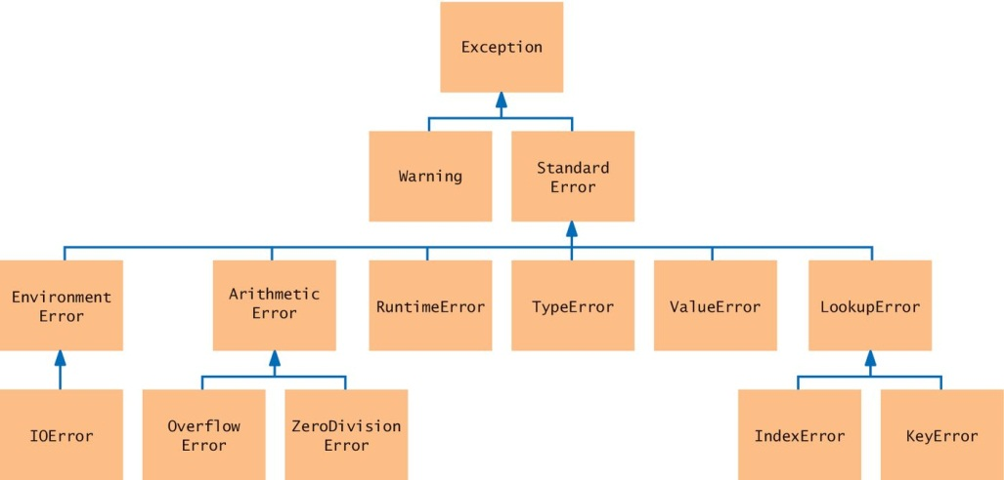
Exception Classes (a subset)
The exception classes are in an inheritance hierarchy.
For the exception type, use the most specific class that can describe the error.

Slide 6
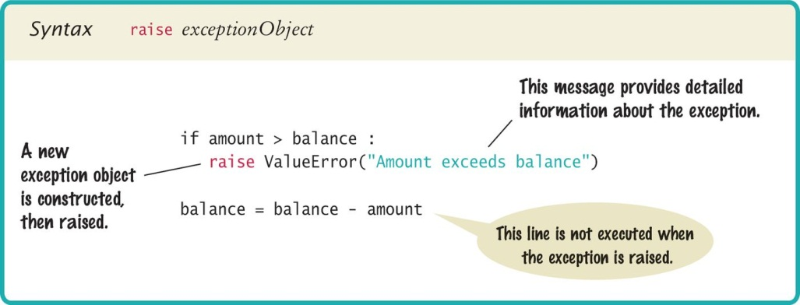
Syntax: Raising an Exception

Slide 7
Handling Errors
Every exception can be handled somewhere in the program.
This is a complex problem. We need to determine:
Which part of the code should handle the exception
How to handle it appropriately
Handling the exception can be:
Simple: exit the program with an error message
User-friendly: Ask the user to correct the error

Slide 8
Handling Exceptions: Try Except
Exception handling is done with the try except statement.
The try except statement is put into a location of our program that knows how to handle a particular exception.
The try block contains one or more statements that may cause an exception of the kind that we can handle.
Each except clause contains the handler for an exception type.

Slide 9
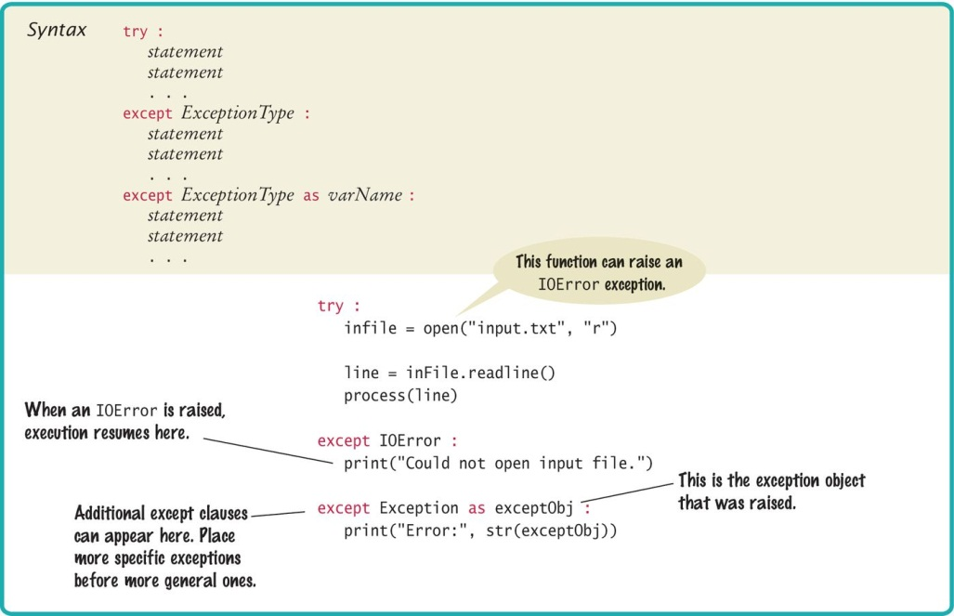
Syntax: Try Except

Slide 10
Try Except: An Example (1)
try :
filename = input("Enter filename: ")
infile = open(filename, "r")
line = infile.readline()
value = int(line)
. . .
except IOError :
print("Error: file not found.")
except ValueError as exception :
print("Error:", str(exception))
. . .
open() can raise an IOError exception
int() can raise a ValueError exception
Execution transfers here if file cannot be opened
Execution transfers here if the string cannot be converted to an int
If either of the exceptions is raised, execution skips the rest of the try block and jumps to the error handling code, and then continues on from the error handling code block.

Slide 11
Try Except: An Example (2)
If an IOError exception is raised, the except clause for the IOError exception is executed, and then execution will continue with the code that follows the exception handling clauses.
If a ValueError exception occurs, then second except clause for ValueError is executed, and then execution will continue with the code that follows the exception handling clauses.
If any other exception is raised, it will not be handled by any of the existing except blocks because the type of exception does not match.
In this case, execution will return from the current function to the calling function, and will keep returning to the next calling functions until:
A try block and matching except clause is found to handle the exception
Execution returns all the way out of main, terminating the program with an exception message.

Slide 12
Output Messages
When the body of this handler is executed, it prints the message included with the exception
except ValueError as exception :
print("Error:", str(exception))
For example, if the string passed to the int() function was "35x2", then the message included with the exception will be:
invalid literal for int() with base 10: '35x2'
To obtain the string, we must have access to the exception object itself by storing the exception object in a variable:
When the handler for ValueError is executed, exception becomes the variable name for the exception object. Then we obtain the message string by calling str(exception)
except ValueError as exception :

Slide 13
Source of Output Messages
When we raise an exception, we can provide our own message string.
Example:
raise ValueError("Amount exceeds balance")
The message of the exception, "Amount exceeds balance", is the string that the exception object will contain.

Slide 14
The finally Clause
In addition to the except clause, there can be a finally clause, which is used when we need to take some action whether or not an exception is raised.
The finally clause is executed whenever the try block is exited in any of three ways:
After completing the last statement of the try block, which is when there is no exception.
After completing the last statement of a except clause, which is when there is an exception that is handled.
When an exception is raised in the try block but is not handled by any except clause.
try
2
1
except
3
2
finally

Slide 15
Example of finally Clause
If we have a function that accepts val as an input and divides 10 by val:
Function call:
def divide(val) :
try :
return 10/val
except ZeroDivisionError :
print("Can't divide by 0")
return None
except TypeError :
print("Can only divide by a number")
return None
finally:
print("done")
Can't divide by 0
done
None
print(divide(0))
print(divide(2))
print(divide('a'))
done
5.0
Can only divide by a number
done
None

Slide 16
Programming Tip for Exceptions
Raise exceptions early
When the code detects a problem that it cannot solve, it is better to raise an exception rather than try to come up with an imperfect fix.
Example: a function whose sole purpose is to read data from a file into a list may not know not what to do if the file is not found. It raises a FileNotFound exception so that execution returns to the caller, which has a higher level view of the application, and would know how to best handle the exception.
Catch exceptions late
Conversely, if a caller doesn’t know how to handle the exception that it receives, the best remedy is simply to let the exception propagate back to the next level caller, until the exception can be handled by code that has a high enough level (main is the highest level) to know the best way to handle the error.

Slide 17
Nested Exception Handling
Sometime we need to split the exception handling into two nested try blocks.
This example shows how to handle a file open error if we don’t use the with statement to open the file.
try
try :
outfile = open(filename, "w")
try :
# Write output to outfile
except ...
...
finally :
out.close() # Close file
except IOError :
# Handle file open exception
try
finally
except

Slide 18
The With Statement
Using the with statement to open a file will simplify the exception handling because we don’t need a finally clause
Here is the same code as on the last slide but it takes advantage of the with statement
try :
with open(filename, "w") as outfile :
# Write output to outfile
except ...
...
except IOError :
# Handle file open exception
If the file open is successful, then the with statement closes the file as soon as execution goes out of the with block. There’s no need for a finally clause just to close the file.

Slide 19
Handling Input Errors

Slide 20
Handling Input Errors
Example with file reading application
Goal: Read a file of data values
First line is the count of values
Remaining lines have data values
Risks:
The file may not exist.
The open() function will raise an exception when the file does not exist
The file might have data in the wrong format.
When there are fewer data items than expected, or when the file doesn’t start with the count of values, the program will raise a ValueError exception.
Finally, when there are more input lines than expected, a RuntimeError exception should be raised.
3
1.45
-2.1
0.05

Slide 21
Handling Input Errors: main Function
main has 2 tasks:
Call readFile to read in all data
Process data
There is no code for input exception handling in main because readFile is in charge of getting the correct input data.
data = readFile(filename)
# Code to process data here...

Slide 22
Handling Input Errors: readFile Function
Has a loop to keep prompting the user for an input file, until the file can be successfully read in.
Exception handling code is in the loop.
def readFile(filename) :
done = False
while not done :
try:
# code to prompt user for a filename here...
with open(filename, "r") as infile :
data = readData(inFile)
done = True
return data
except IOError:
print("File not found.")
except ValueError :
print("File content invalid.")
except RuntimeError as error:
print("Error:", str(error))

Slide 23
Raising Input Errors: readData Function
No exception handling code, but has code to raise exceptions as they’re detected.
Data is only returned if the file is read in successfully.
def readData(inFile) :
line = inFile.readline()
numberOfValues = int(line) # May raise a ValueError exception
data = []
for i in range(numberOfValues) :
line = inFile.readline()
value = int(line) # May raise a ValueError exception
data.append(value)
# Make sure there are no more values in the file.
line = inFile.readline()
if line != "" : # Extra data in file
raise RuntimeError("End of file expected.")
return data

Slide 24
One Scenario
From the example input file exception handling:
main calls readFile
readFile calls readData
readData calls int
There is no integer in the input, int raises a ValueError exception
readData has no except clause; it terminates immediately and returns to readFile
readFile has the except clause to print the error message; then the loop in readFile prompts the user for another filename and repeat the call the readData in step 3.
The next time the input file is read in successfully, readData returns the data to readFile.
readFile ends the loop and returns to main; the returned data is stored in main for processing.

Slide 25
Handling Input Errors: Terminate Program
In the previous example for input exception handling, there is a loop that contains the try except blocks so that the user can be prompted for another input filename.
Another way to handle input file error can be to terminate the program with an error message. This way the user can figure out the correct filename or file location before running the program again.
In other languages, we call the exit function when the program needs to be terminated.
In Python the standard practice to terminate a program is by raising the exception SystemExit
The program will end with the error message that we pass in to SystemExit, and the output will print an exit code of 1 to show that the program did not run completely to the end.
except FileNotFound :
raise SystemExit(“Error opening input file”)

Slide 26
Detecting Error During Development: Assert
In addition to using try except for handling errors, software developers also use assert statements to catch errors during the development phase (coding / unit testing) of a software project.
The assert statement is added to code to assert or enforce that a certain condition is true before executing the next part of the code.
If the condition is false, then an AssertionError exception is raised and the program terminates.
Assert statements are used in large software projects. For example:
We write a function which will be called by other modules in the project. This function requires a certain pre-condition, a condition that must exist before the function runs.
But when our function is called, we’re not sure that the caller has set up the pre-condition.
In our function, we can add an assert statement to make sure that the pre-condition is true before our code runs.

Slide 27
Assert Statement
assert expression, "error message"
Format of assert:
The expression is evaluated to True or False
If True: execution continues to the next line of code.
If False: AssertionError exception is raised, the error message is printed and the program terminates.
Example:
If temp is 0: returns 32.0
If temp is -3:
Assert statements are not evaluated by Python in production code, therefore, use try except or if statements to catch general errors.
def KelvinToFahrenheit(temp):
assert temp >= 0, "colder than absolute zero"
return temp * 1.8 + 32
KelvinToFahrenheit(-3)
assert temp >= 0, "colder than absolute zero”
builtins.AssertionError: colder than absolute zero

Slide 28
End of Exception Handling Notes

